Slide 1
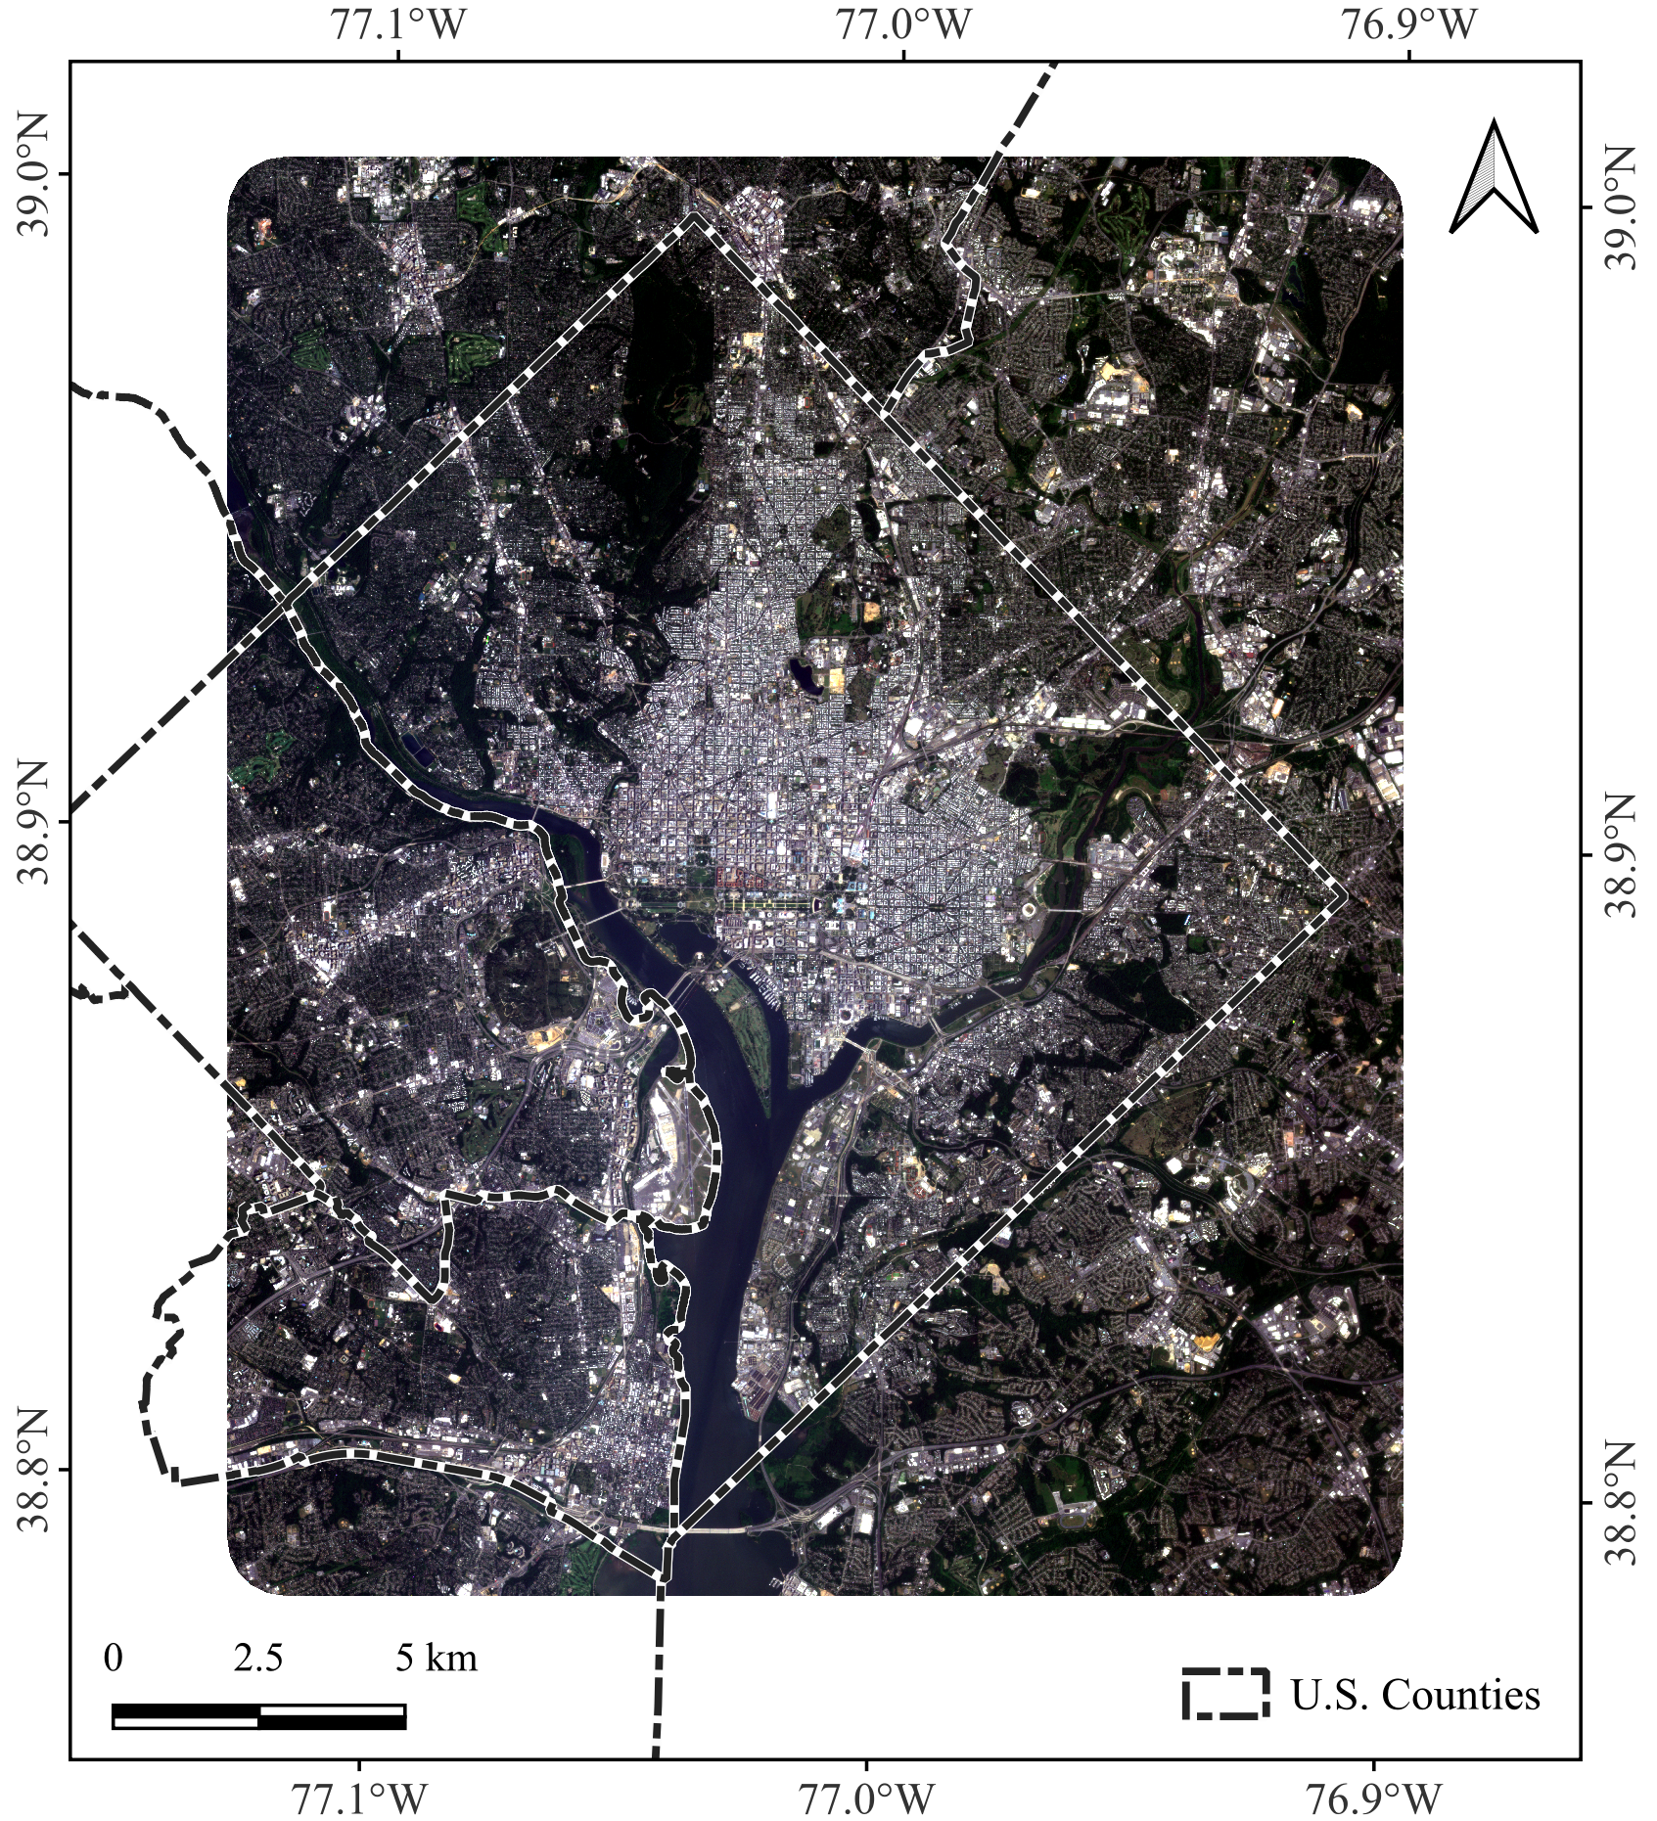
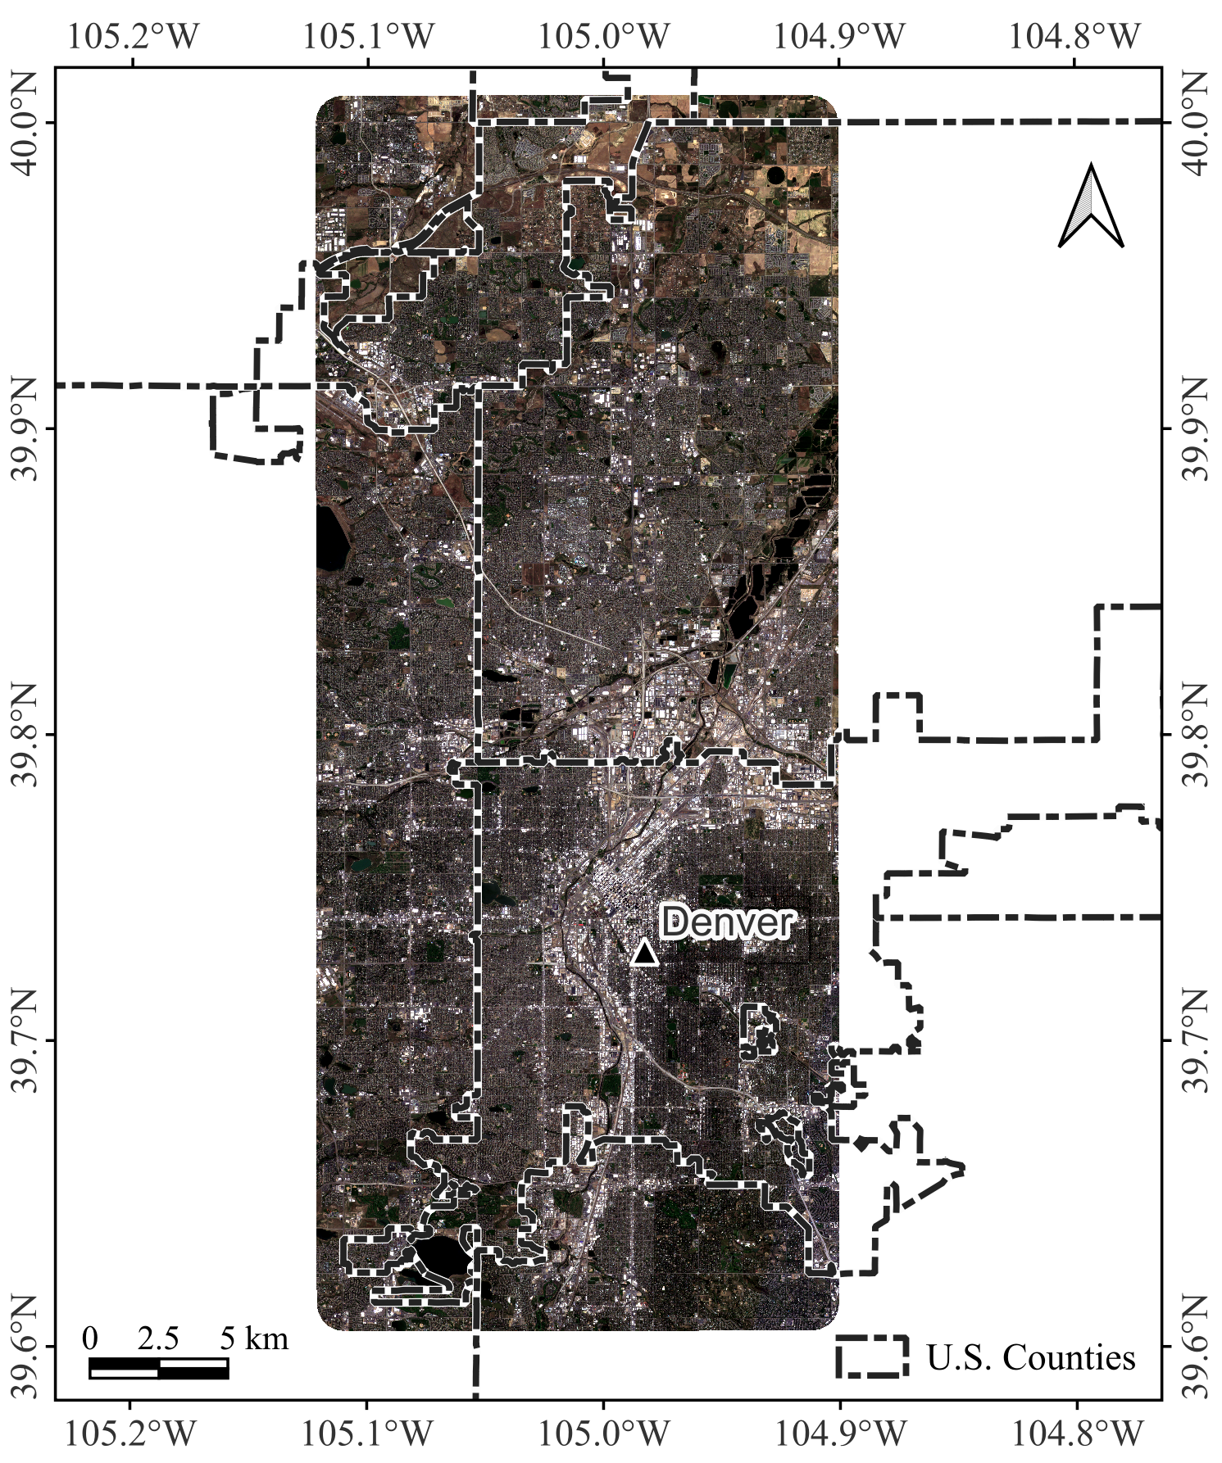
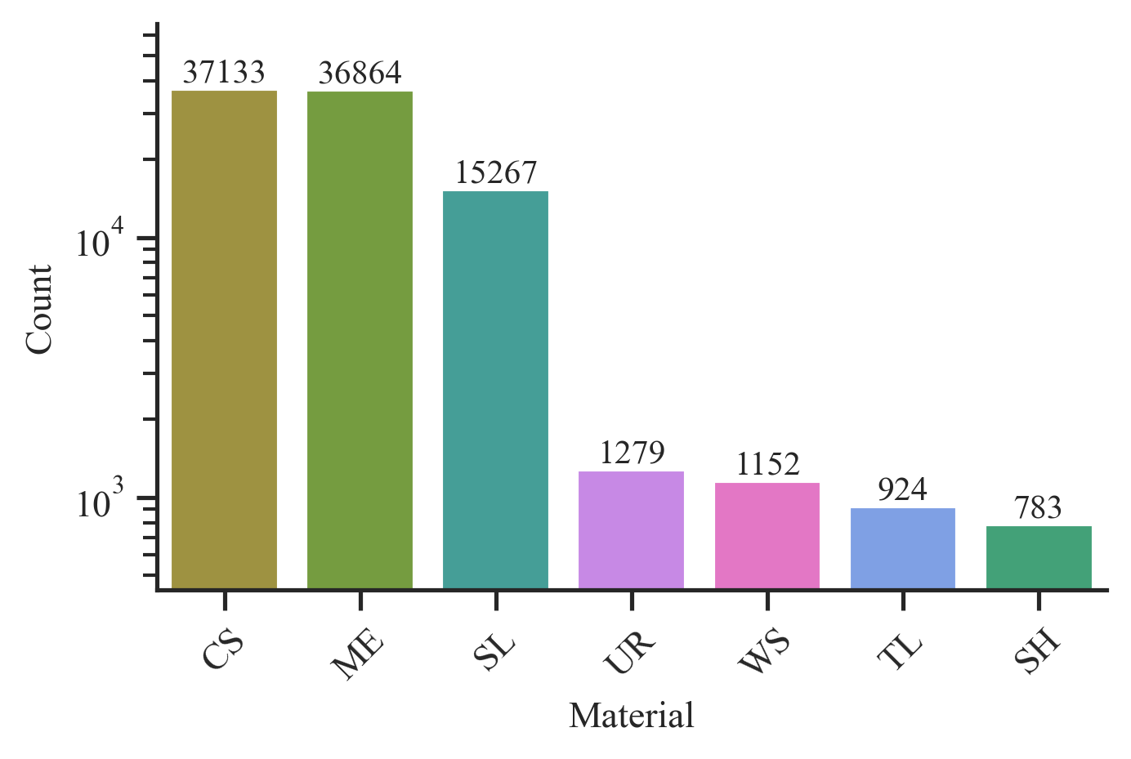
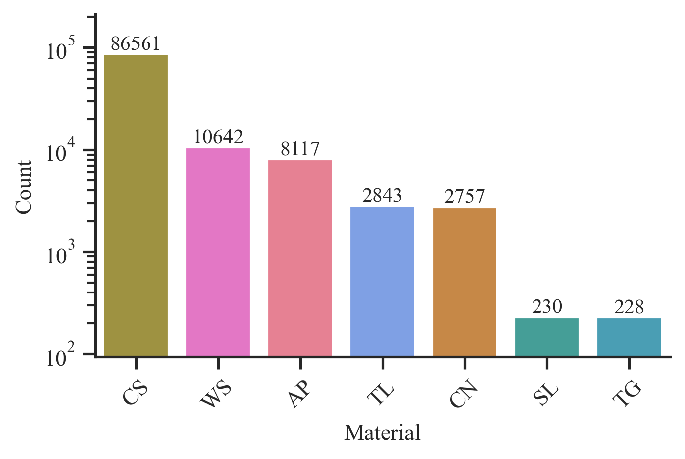
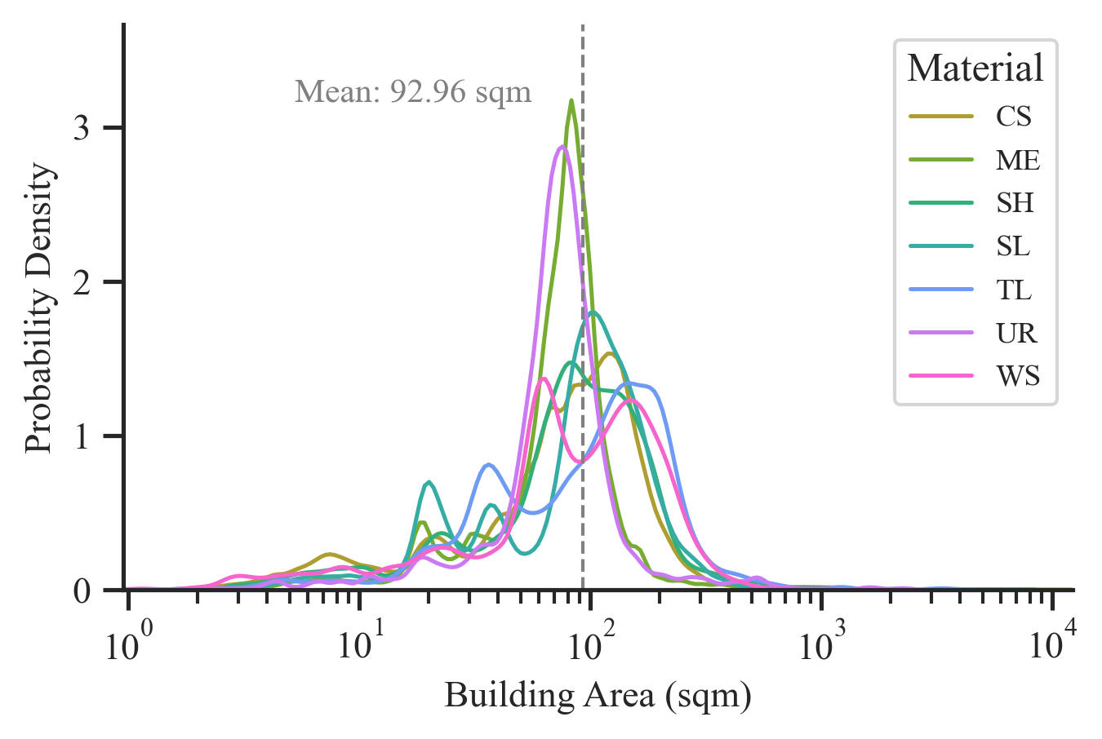
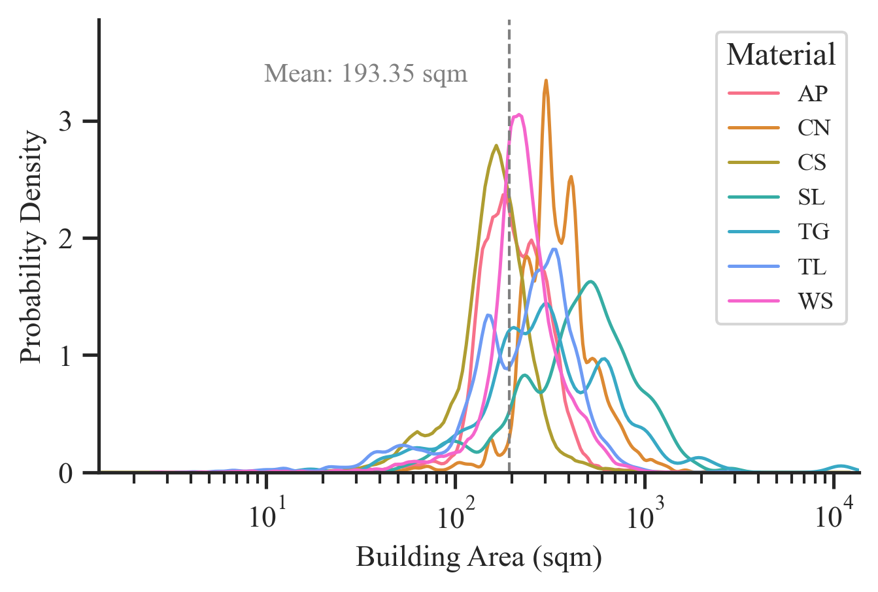
(a)
(b)
(c)
(d)
(e)
(f)
Figure 1. Study area map with (a-b) Planet PSB.SD true-color (Red-Green-Blue) composites, (c-d) log-scaled distribution of roof material classes and (e-f) log-scaled distribution of building indoor areas. AP=Asphalt; CN=Concrete; CS=Composition Shingle; ME=Metal; SH=Shingle; SL=Slate; TL=Tile; TG=Tar and Gravel; UR=Urethane; WS=Wood Shake/shingle.

Slide 2
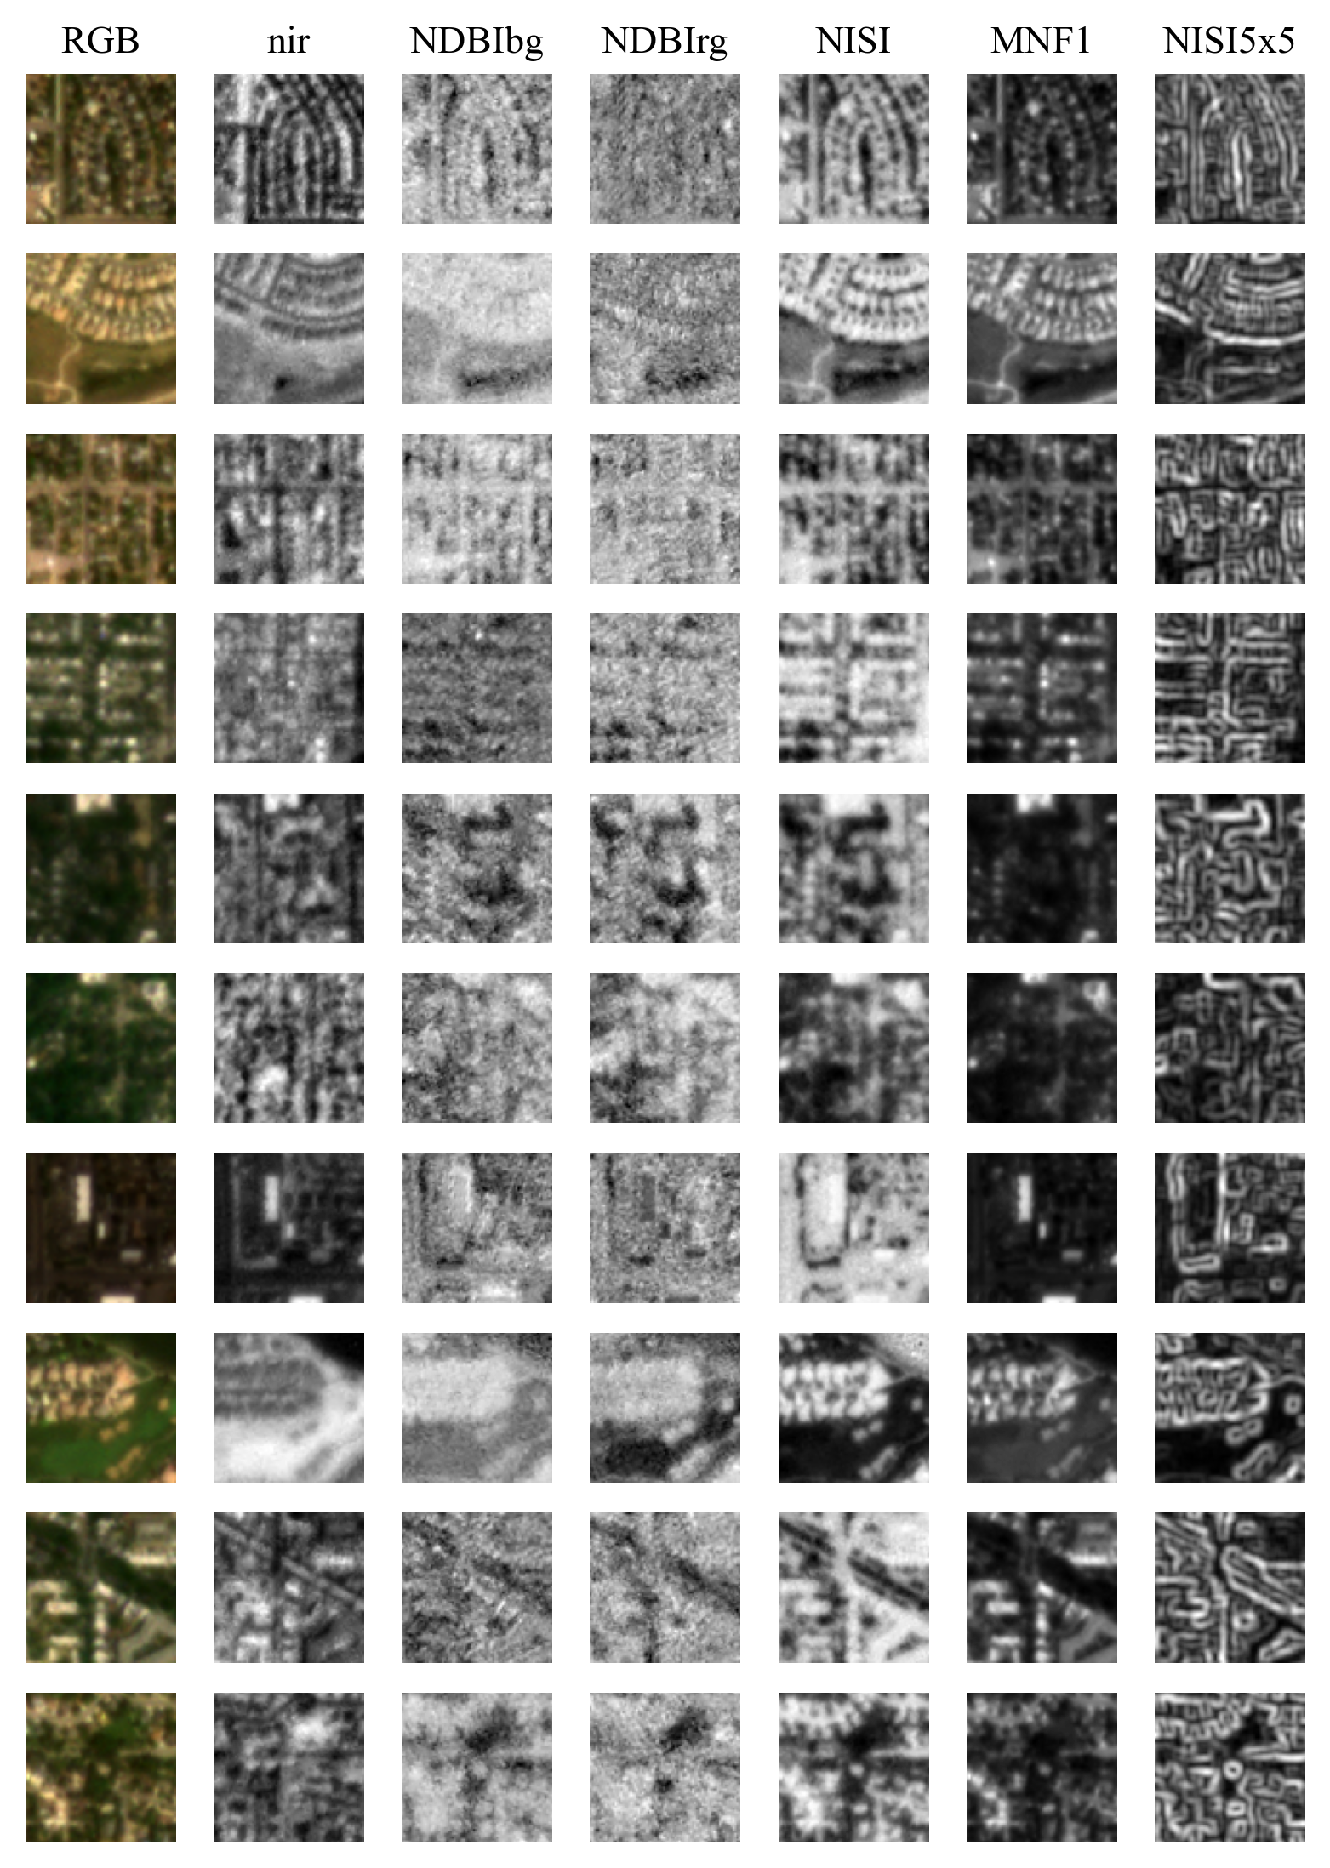
Asphalt
Concrete
Composition shingle
Metal
Shingle
Slate
Tar and gravel
Tile
Urethane
Wood shingle
Figure 2. Example image chunks with 78x78 dimensions for roof material classes in both D.C. and Denver with RGB true-color and bands used in classification models from the PSB.SD. If a class exists in both regions, the region with the larger sample size for that class was used to select a random labeled image chunk. AP=Asphalt; CN=Concrete; CS=Composition Shingle; ME=Metal; SH=Shingle; SL=Slate; TL=Tile; TG=Tar and Gravel; UR=Urethane; WS=Wood Shake/shingle.

Slide 3
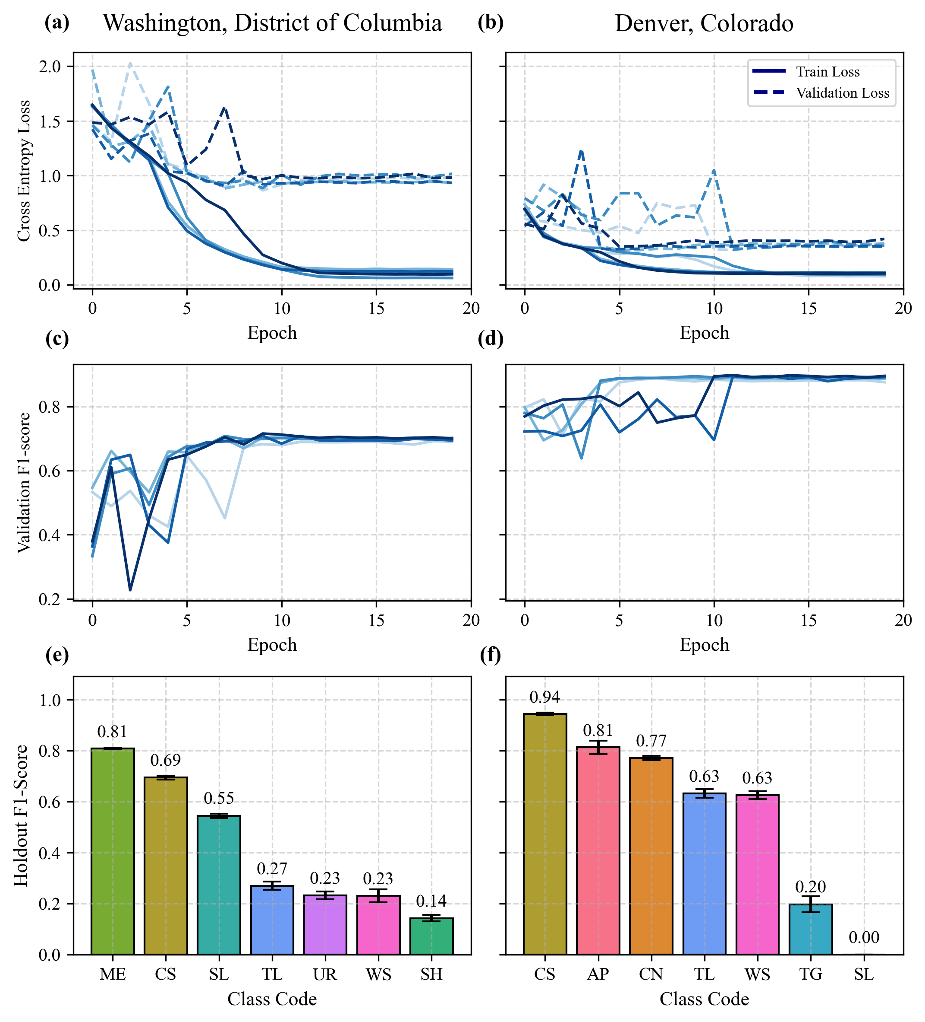
Figure 3. Results from 5-fold cross-validation ResNet-18 model. (a, b) Model Cross Entropy Loss functions for training (-) and validation (--) across epochs and folds; (c, d) Validation weighted F1-score across epochs and folds; (e, f) Holdout weighted F1-score across folds for each roof material class. AP=Asphalt; CN=Concrete; CS=Composition Shingle; ME=Metal; SH=Shingle; SL=Slate; TL=Tile; TG=Tar and Gravel; UR=Urethane; WS=Wood Shake/shingle.

Slide 4
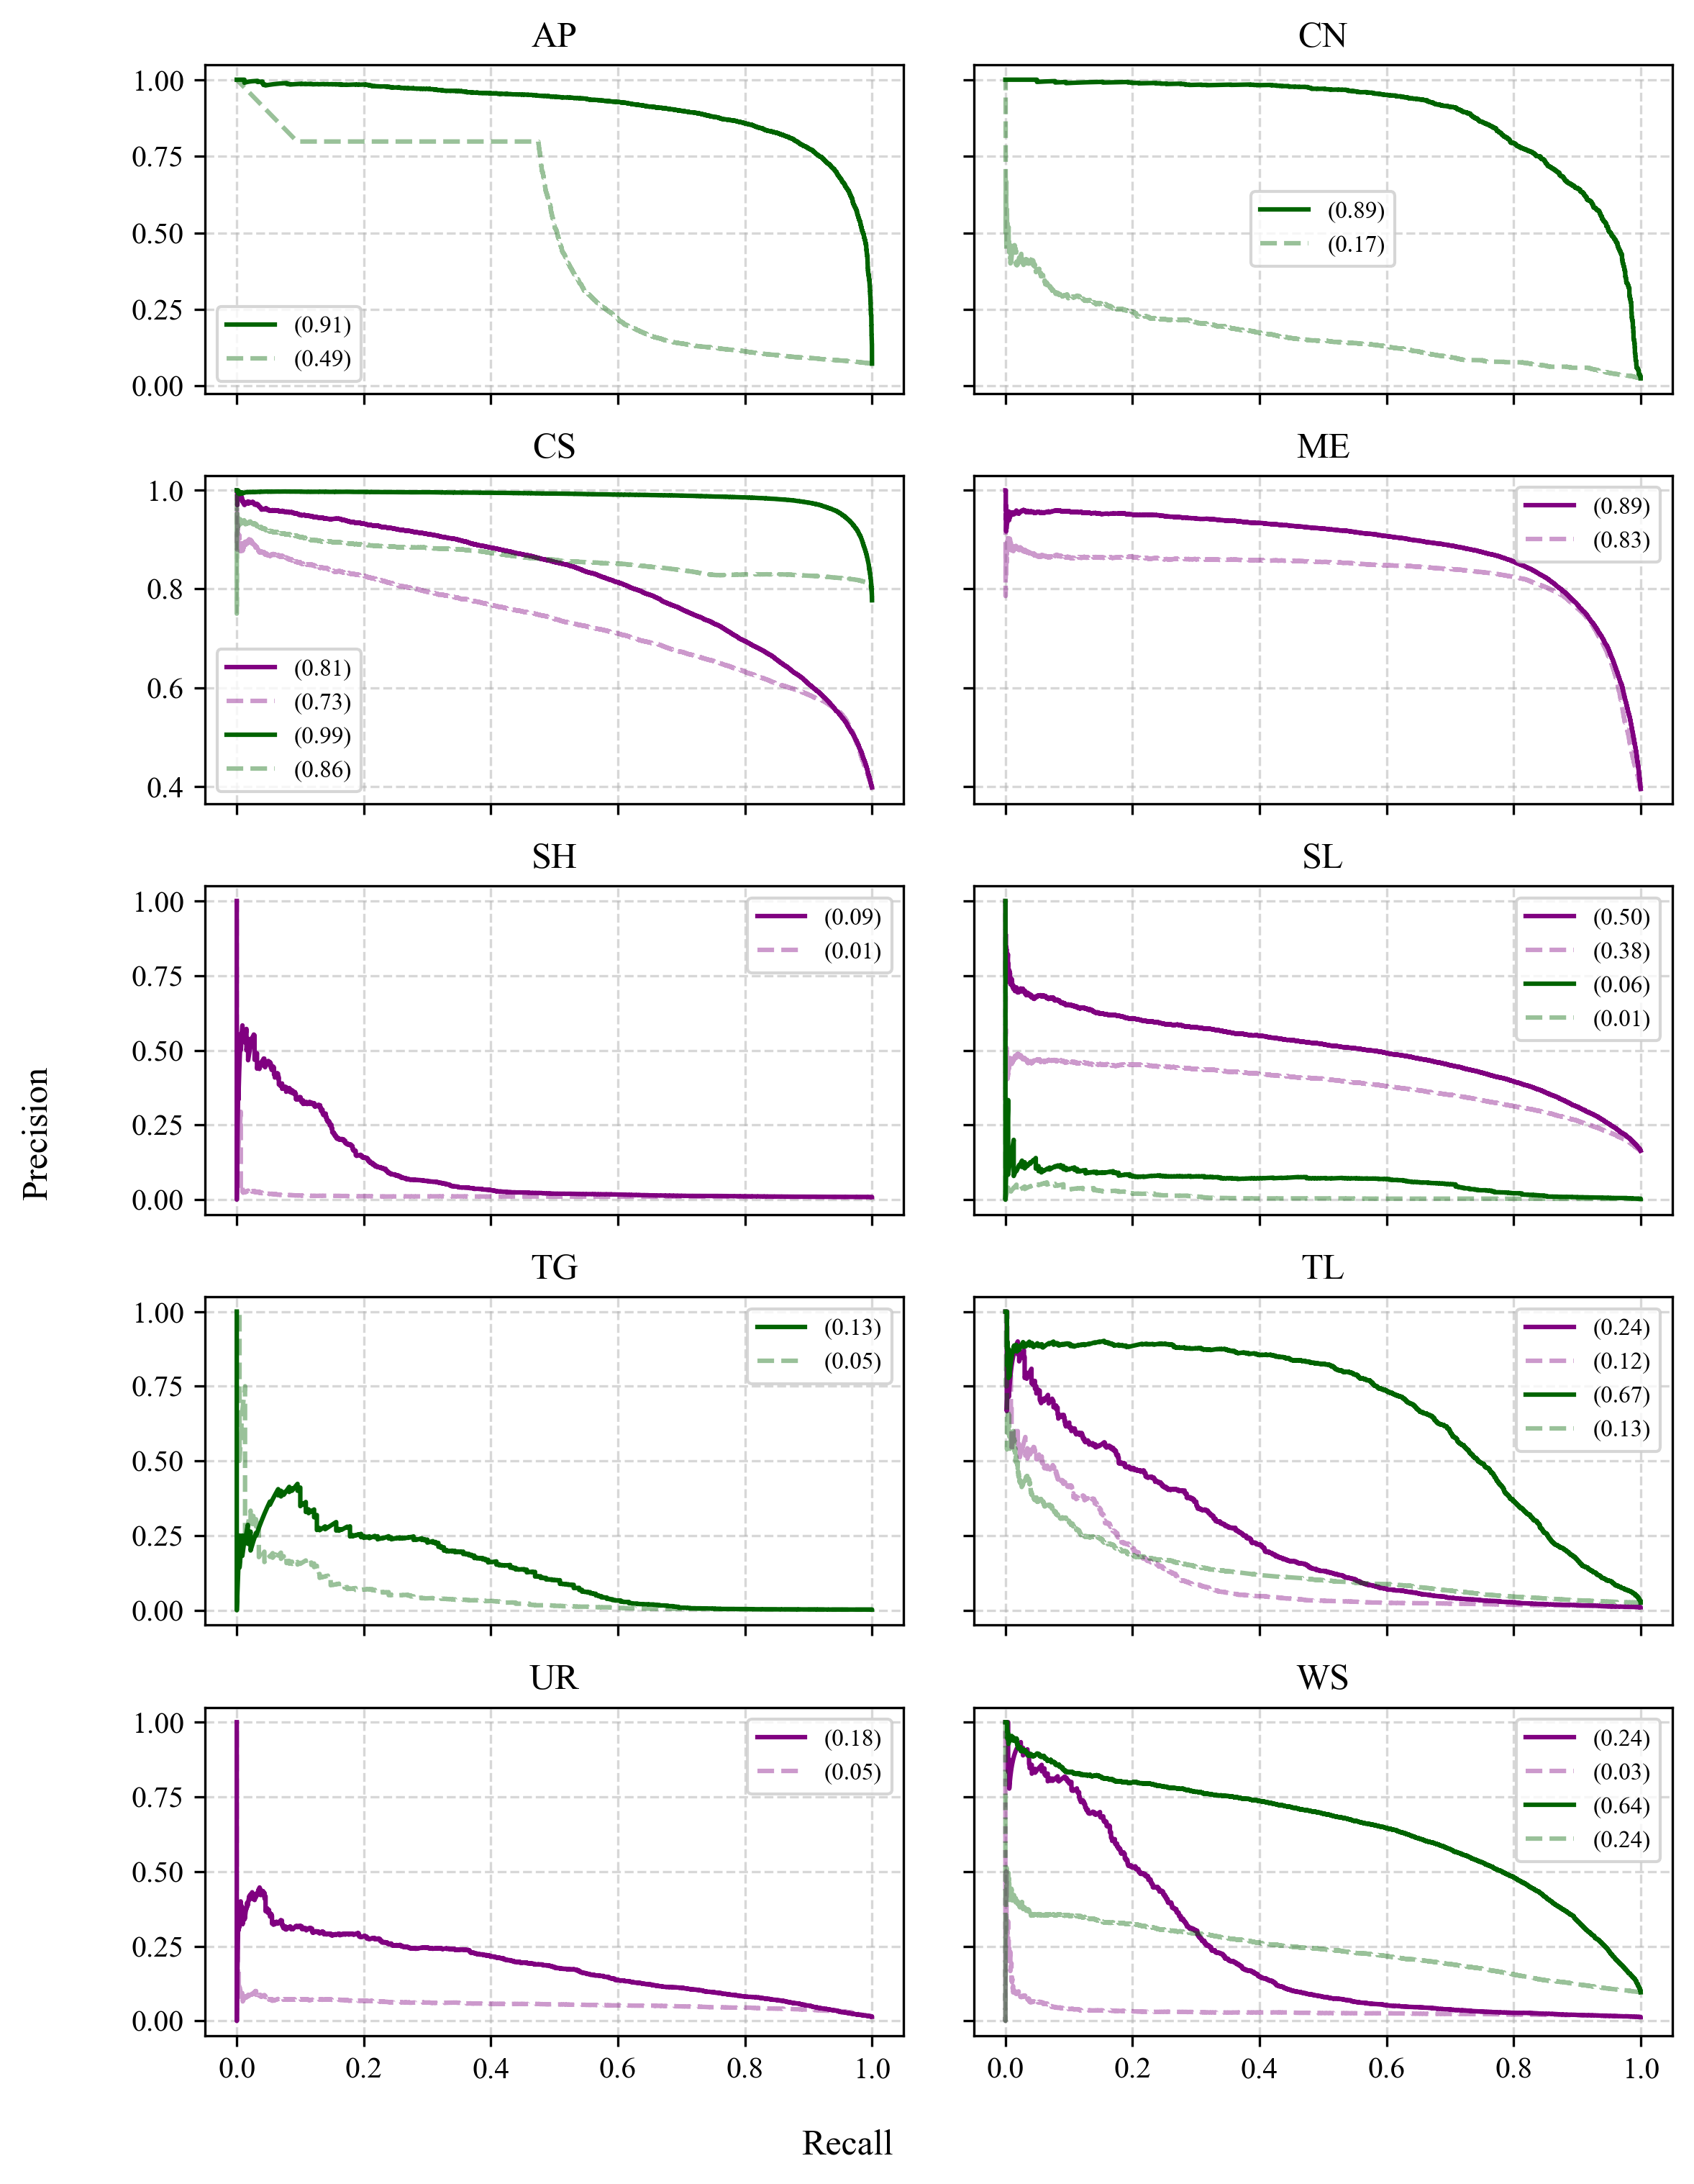

Slide 5
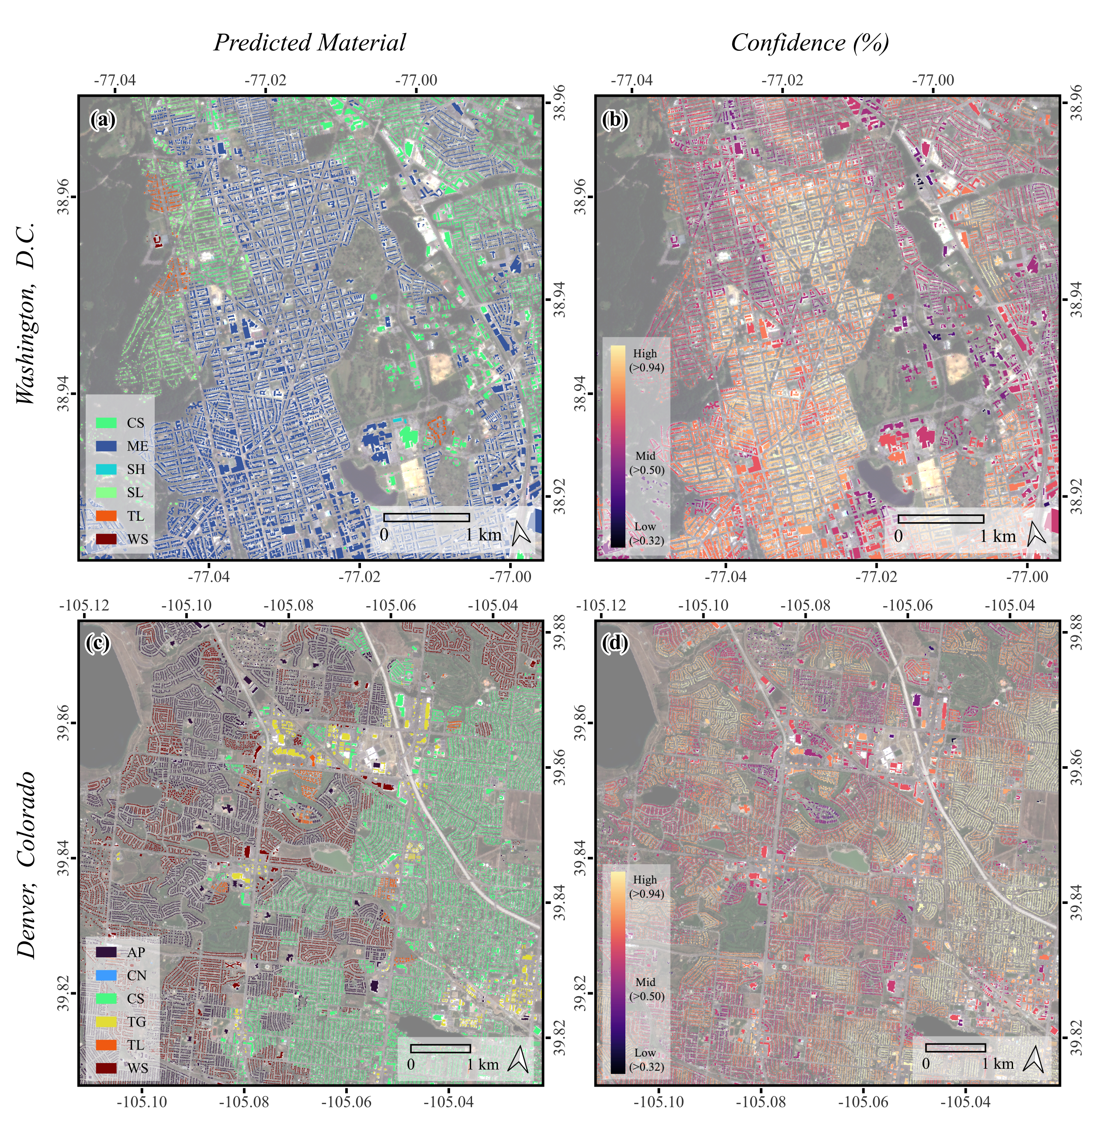

High
(>0.94)
Mid
(>0.50)
Low
(>0.32)

Slide 6
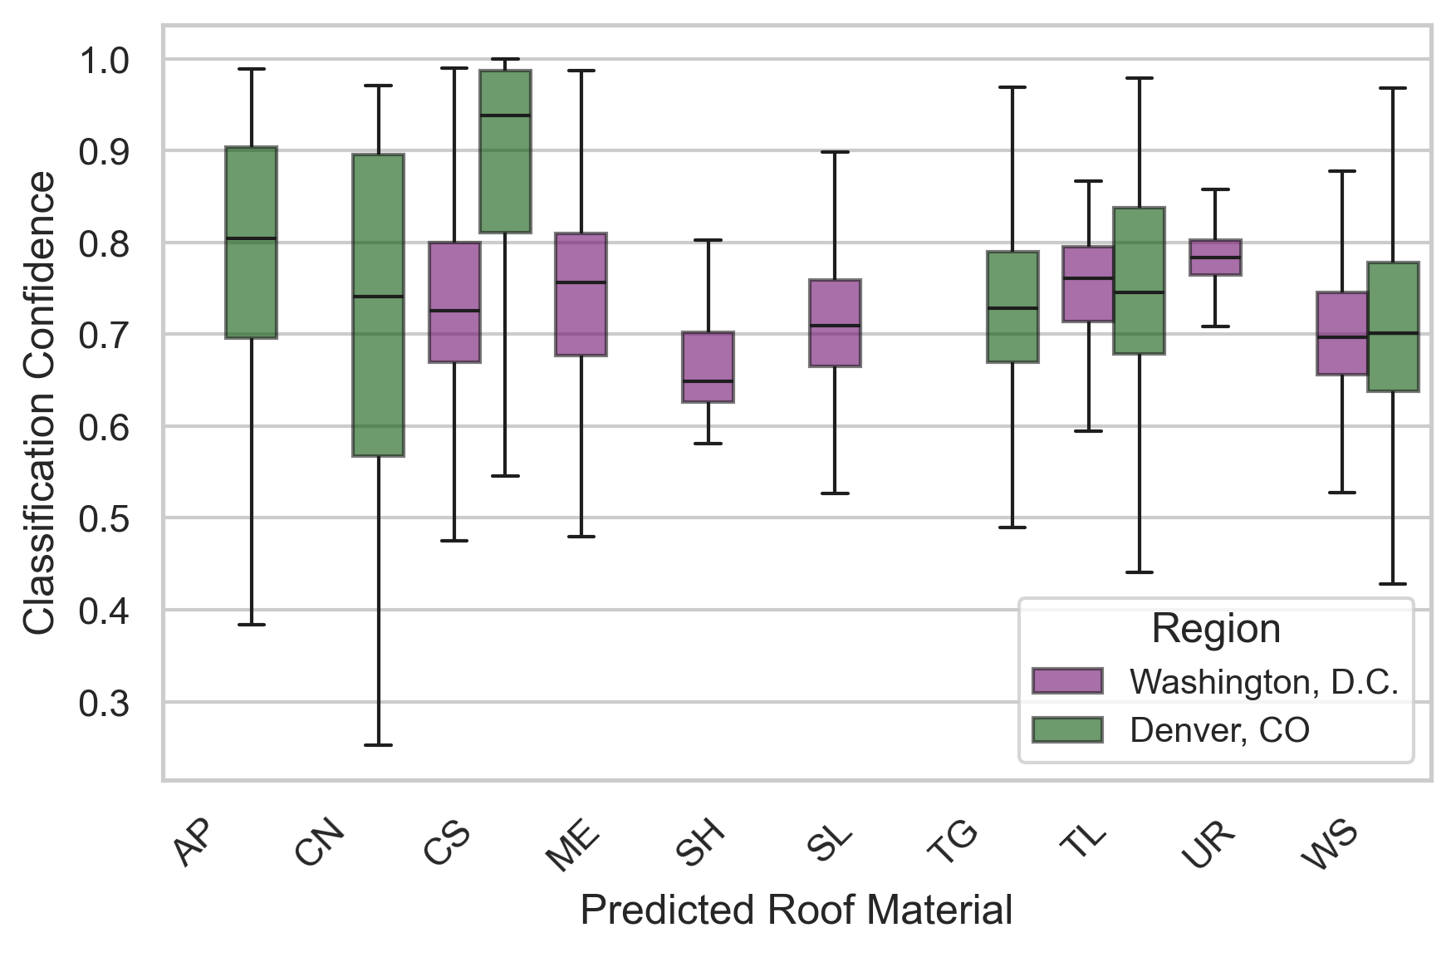
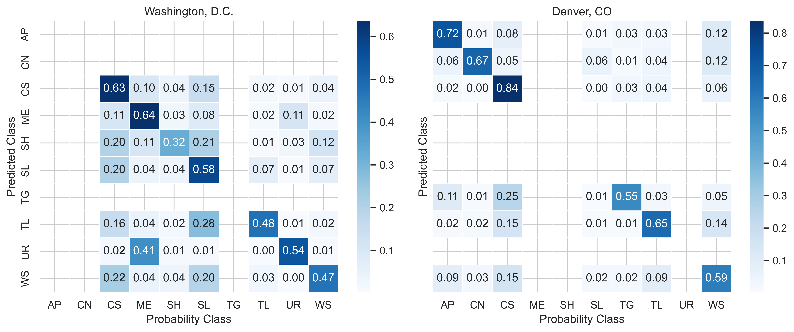

Slide 7
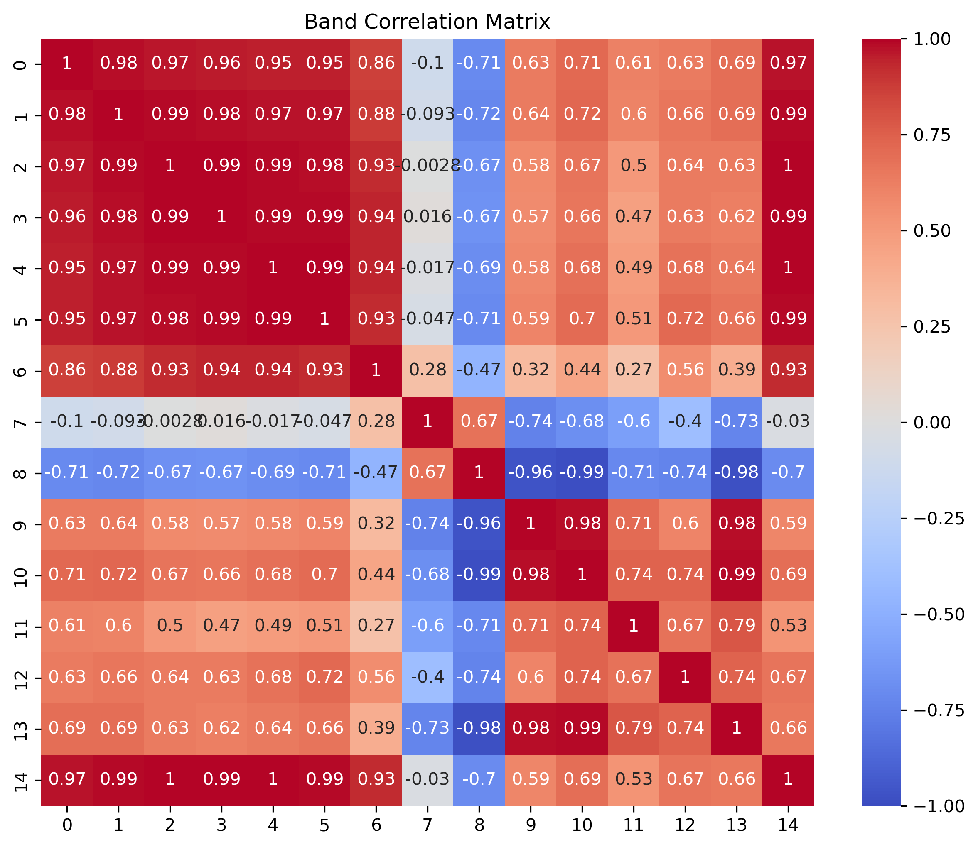
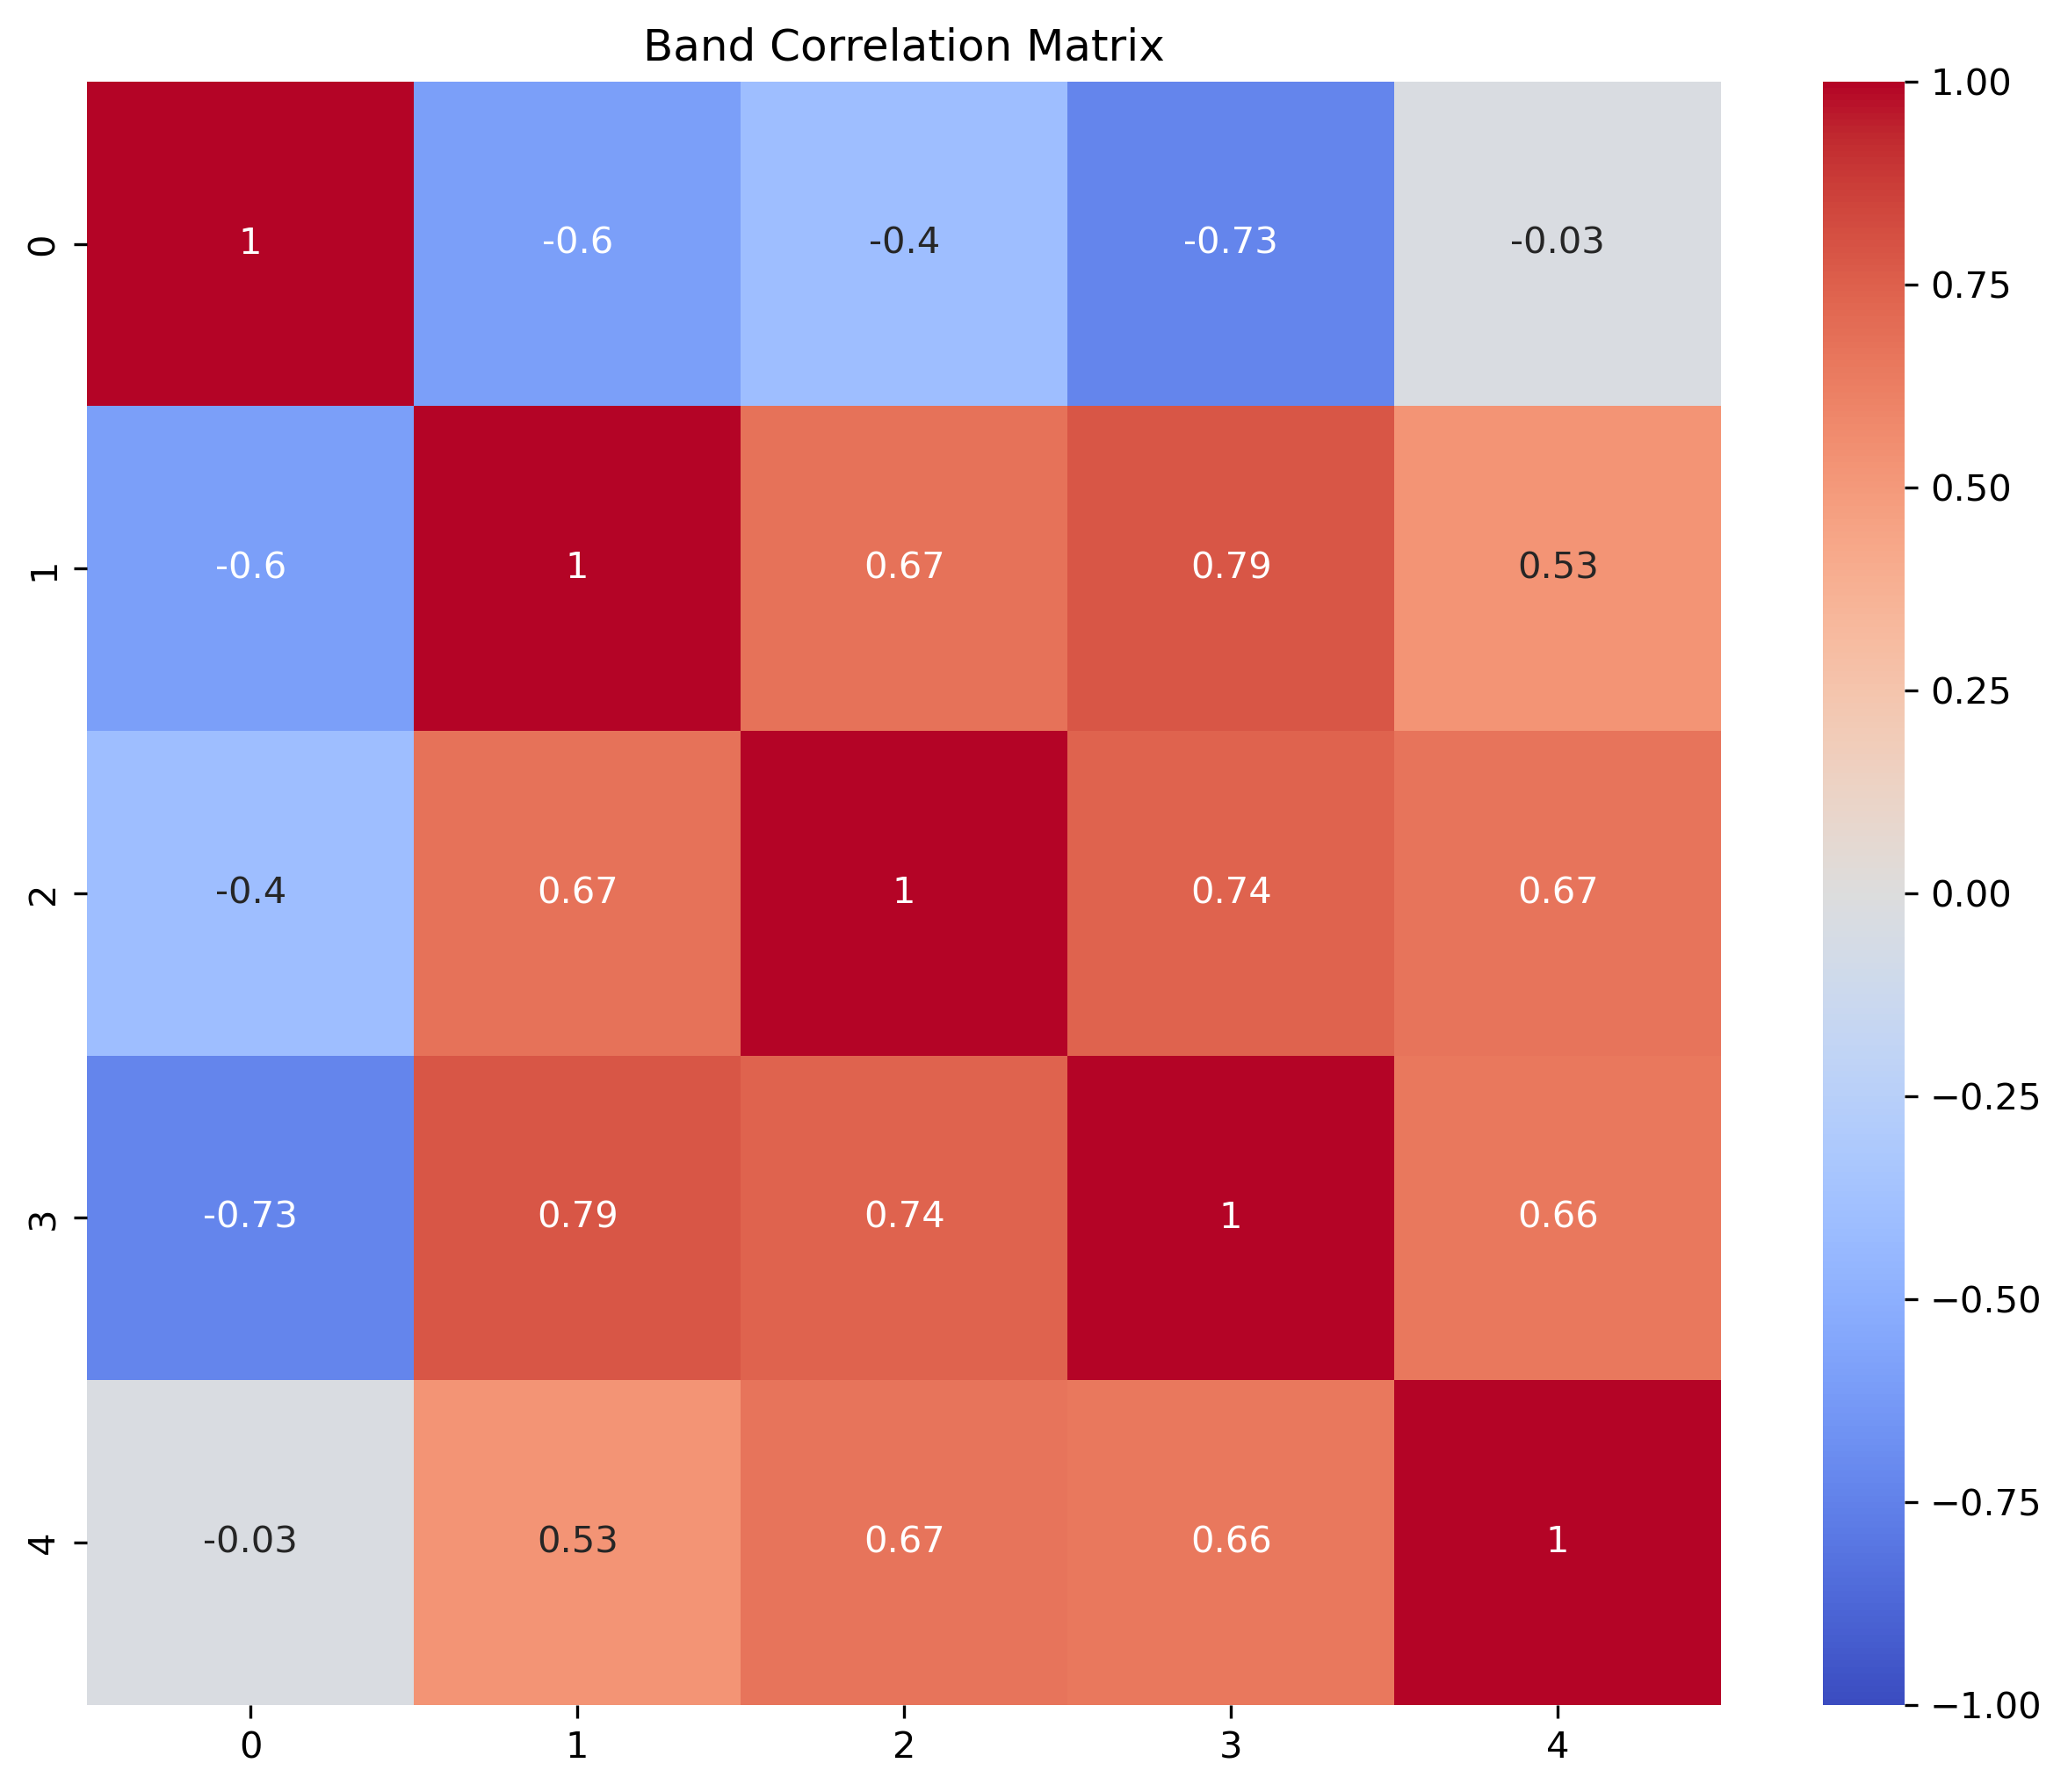
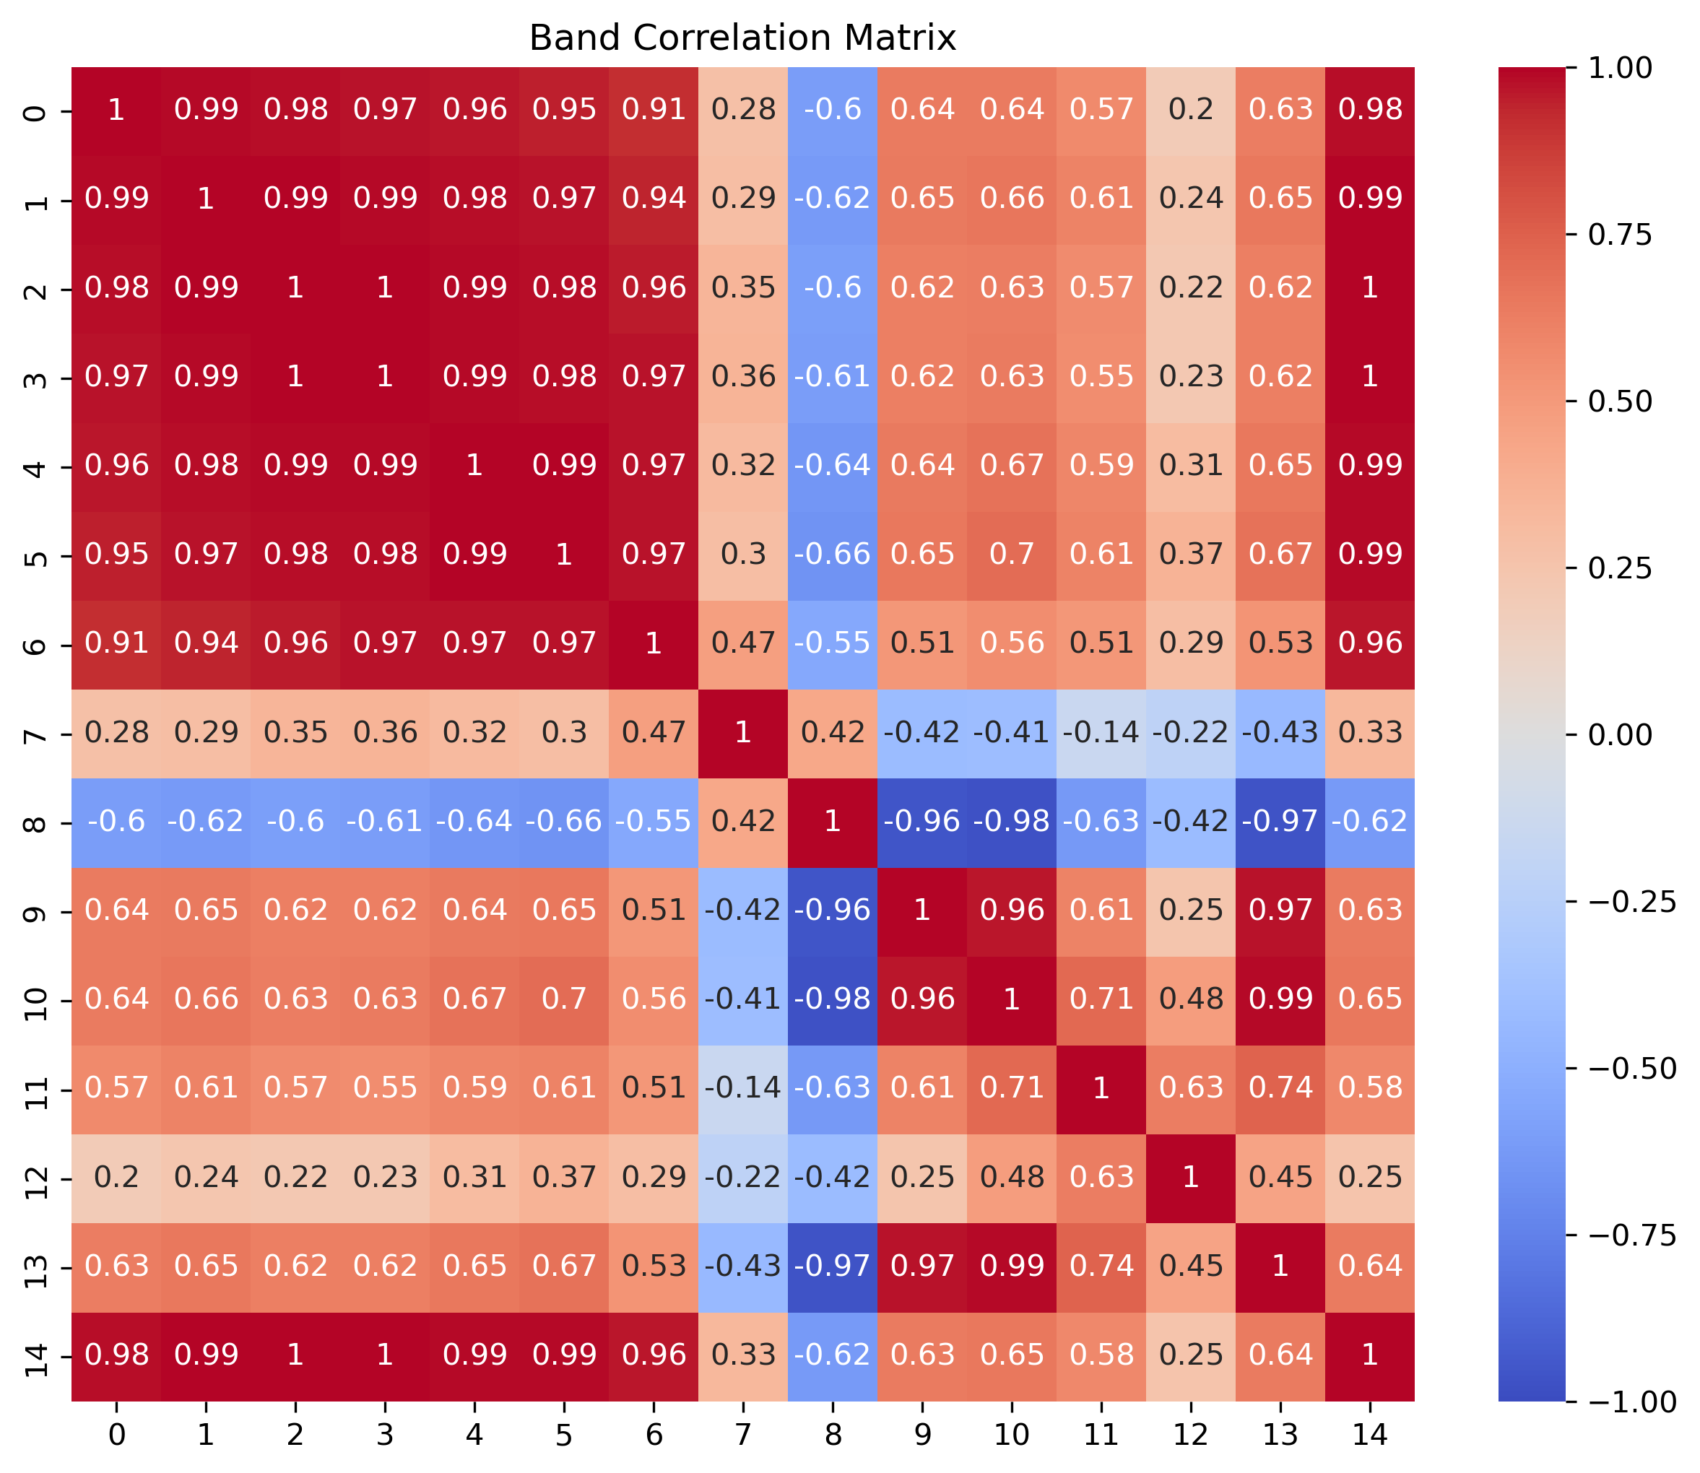
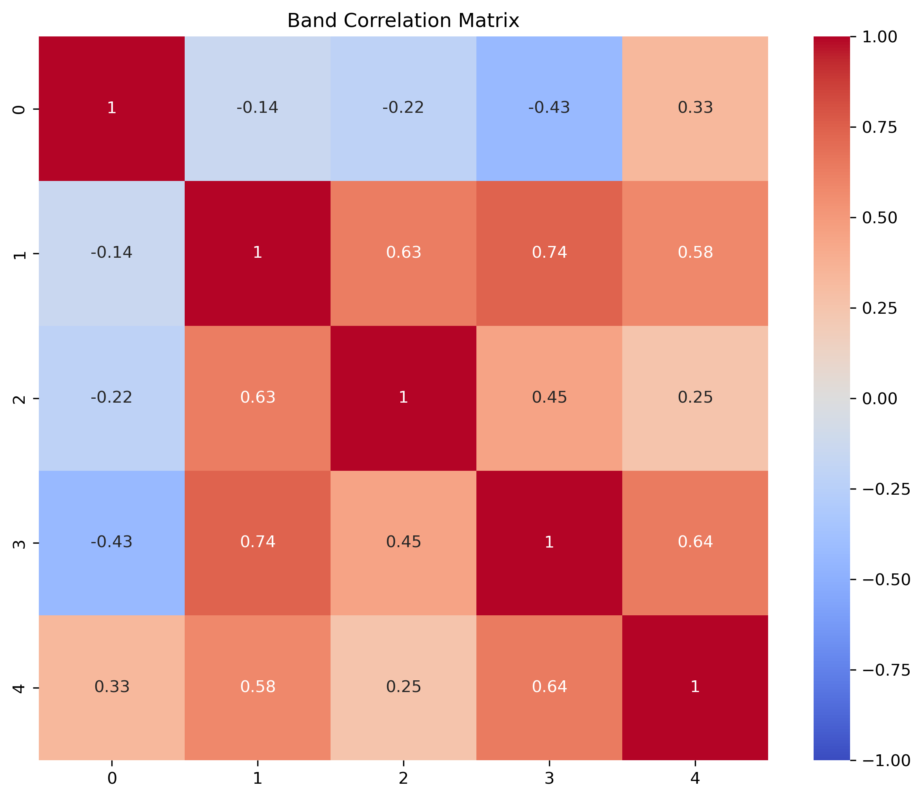
Figure SX
(a)
(b)
Washington, D.C.
(c)
(d)
Denver, Colorado

Slide 8
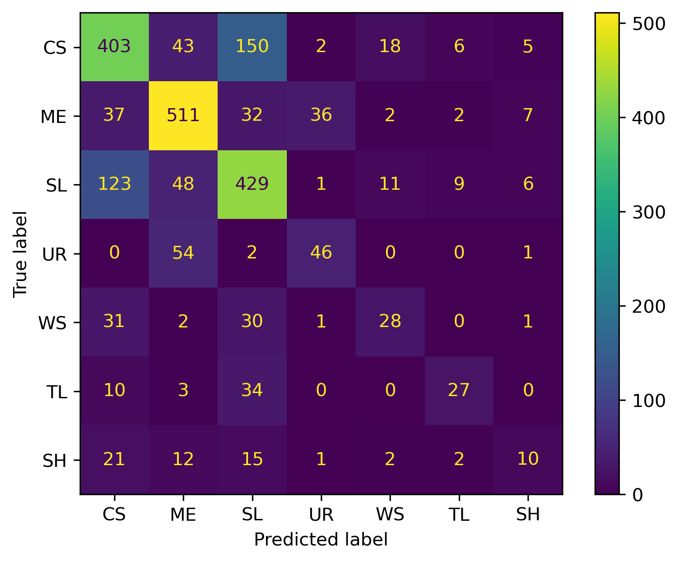
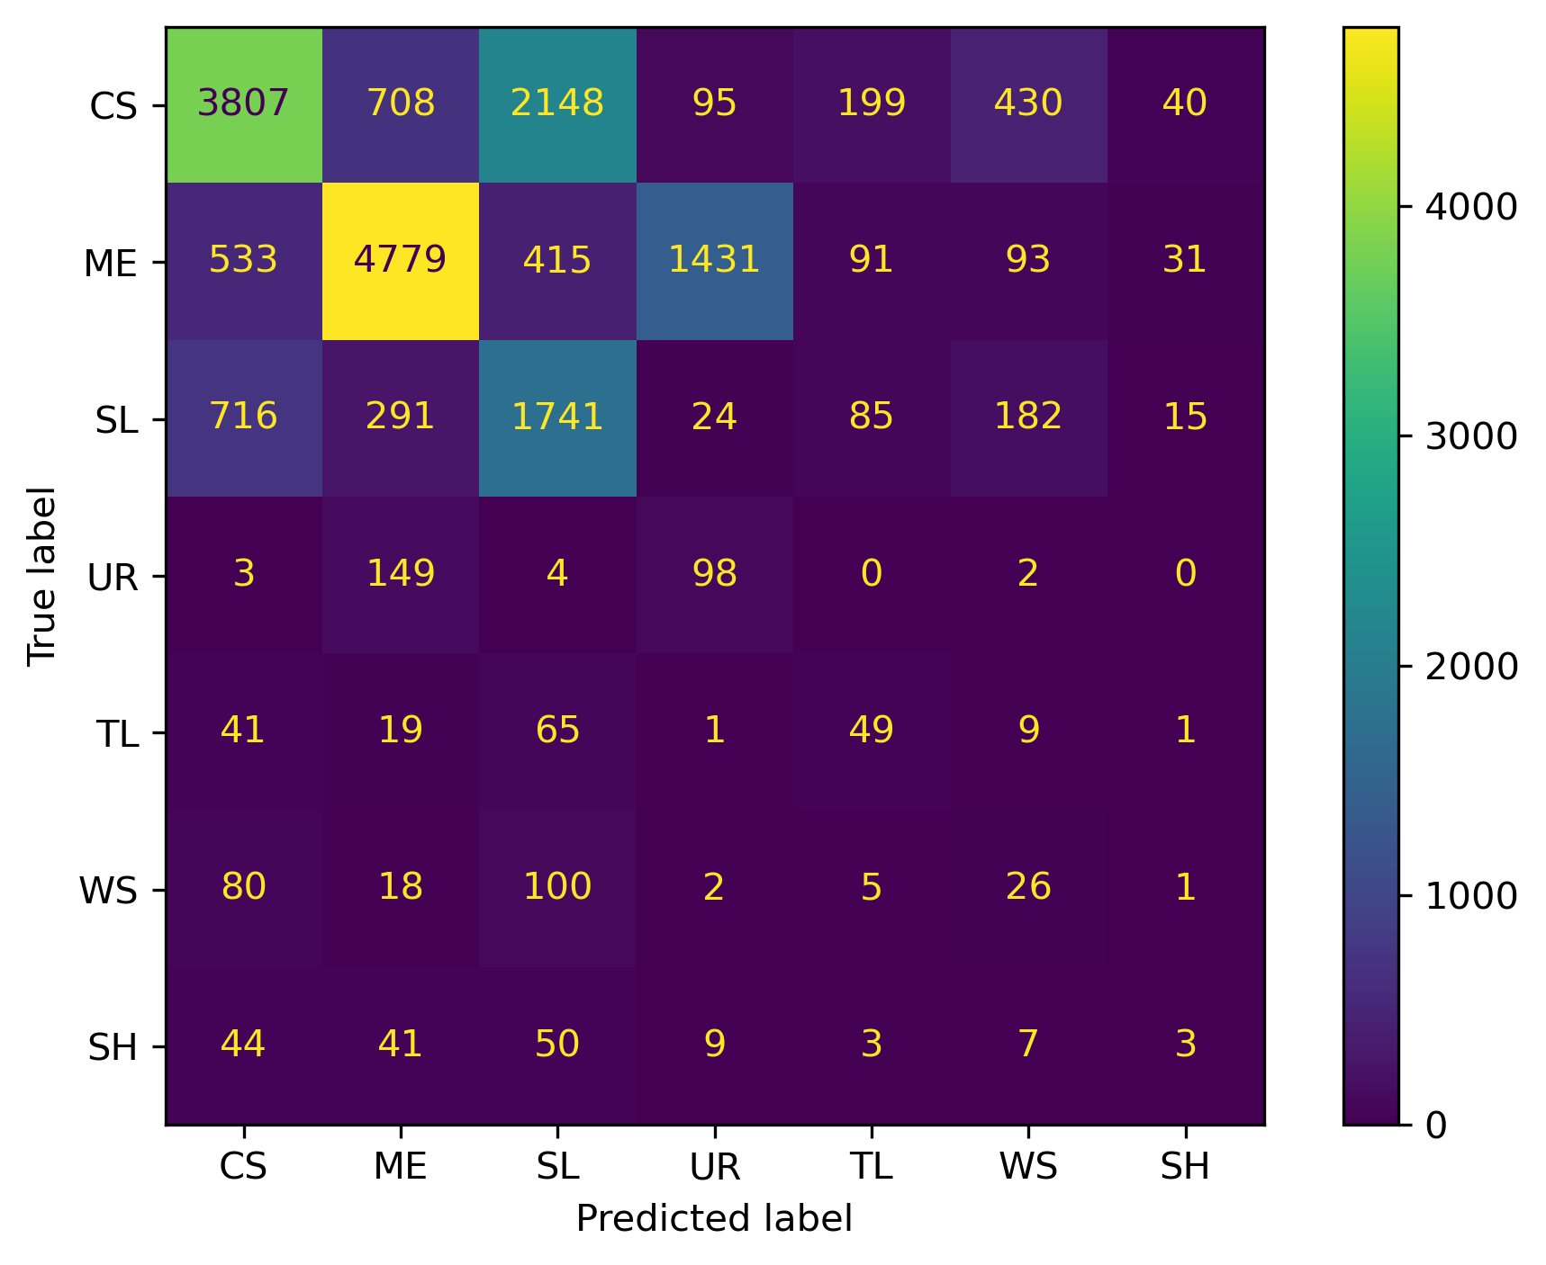
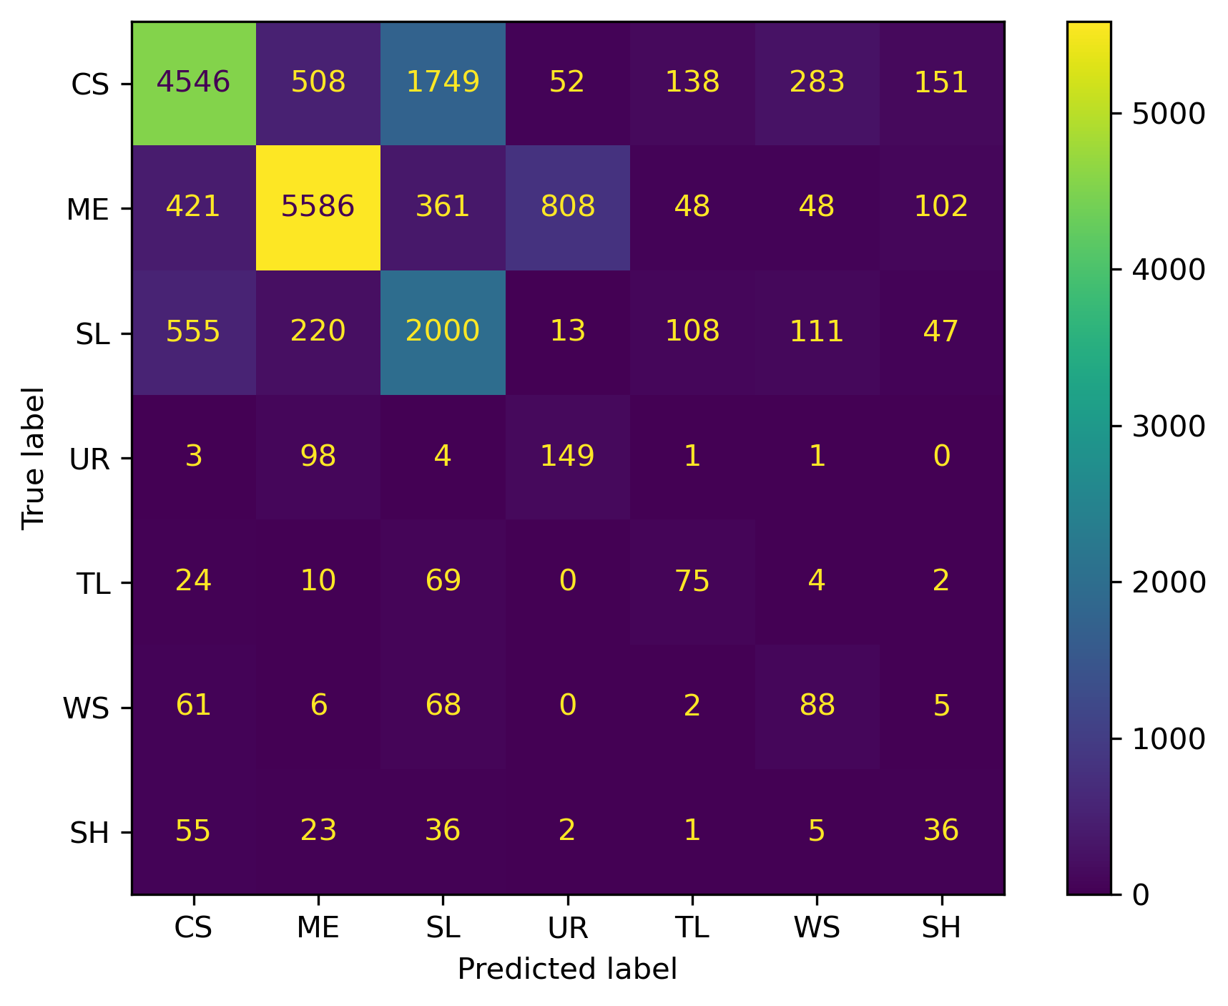
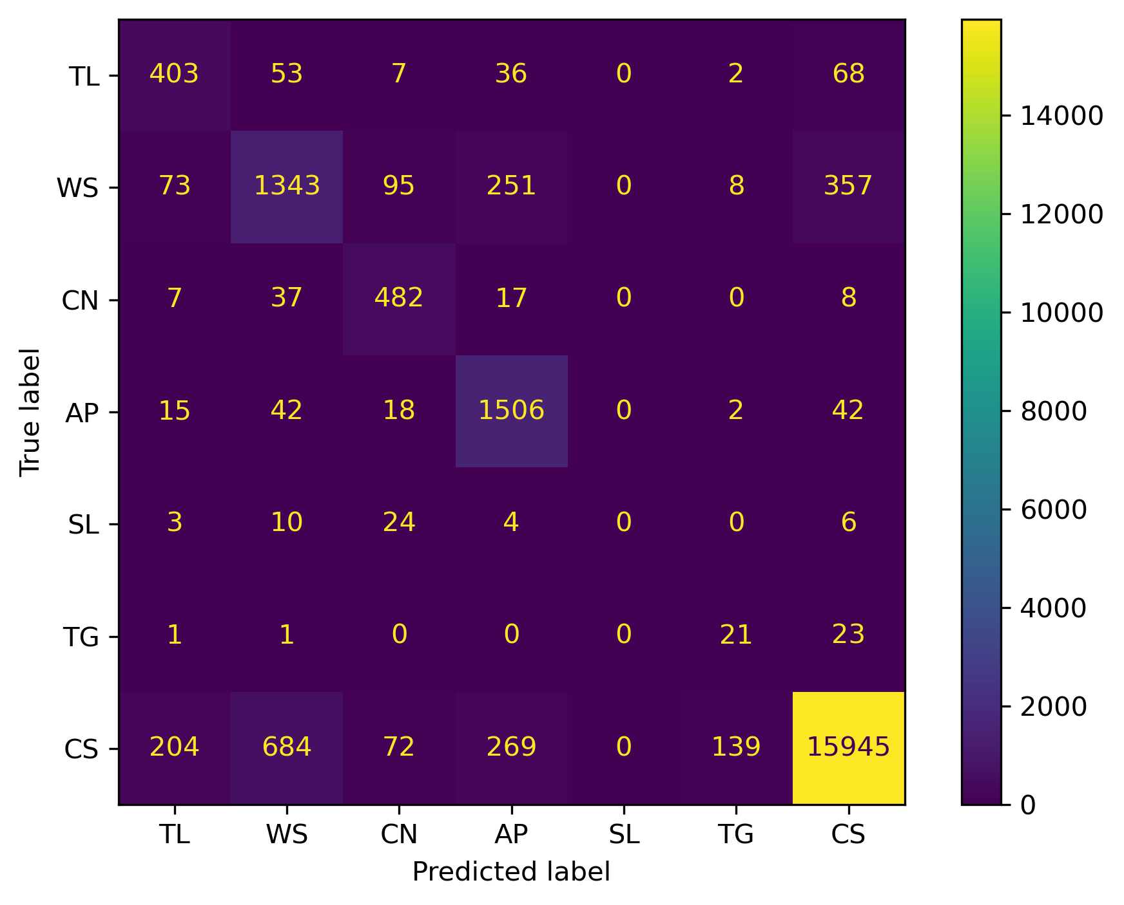
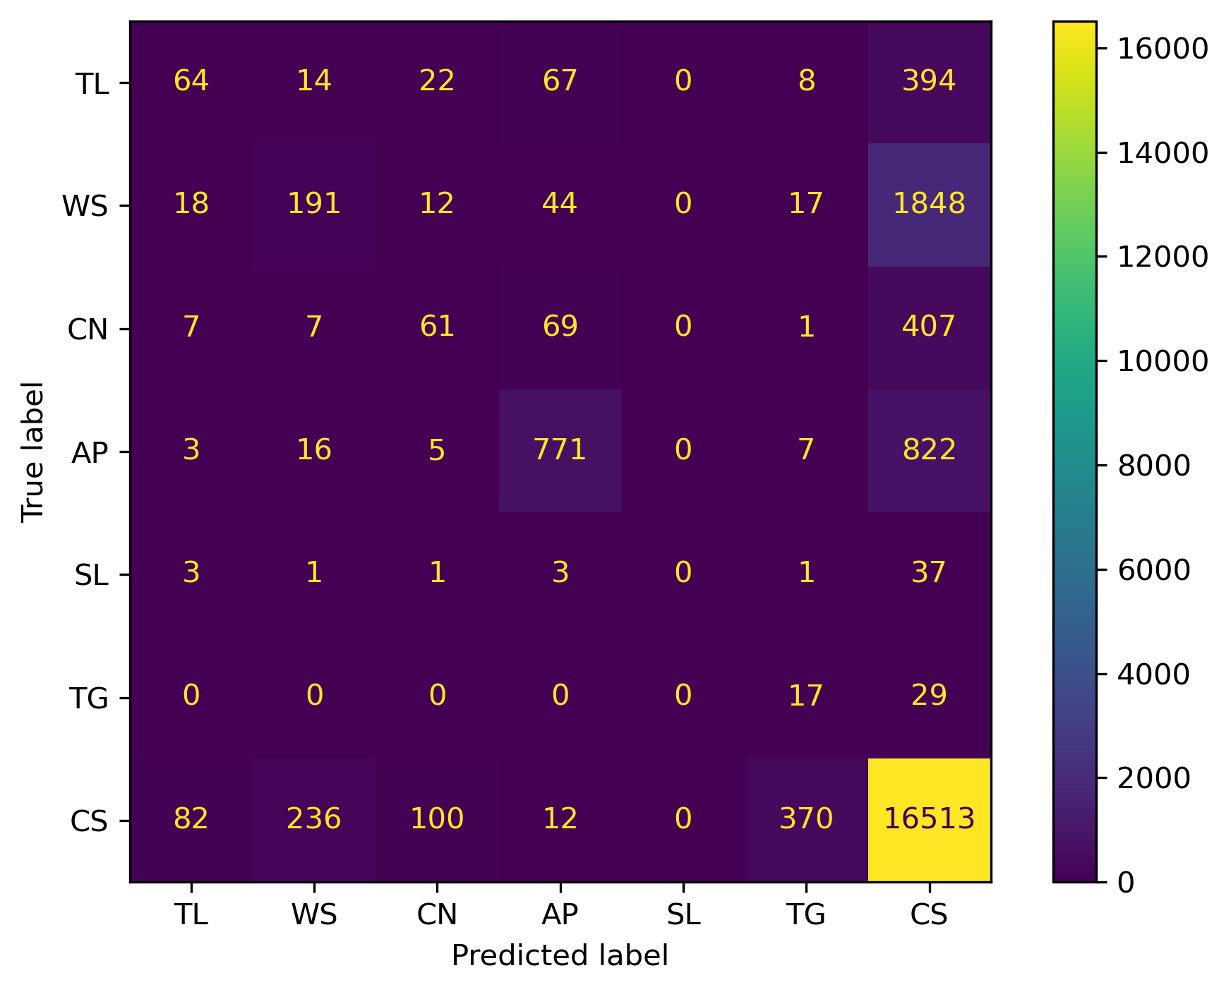
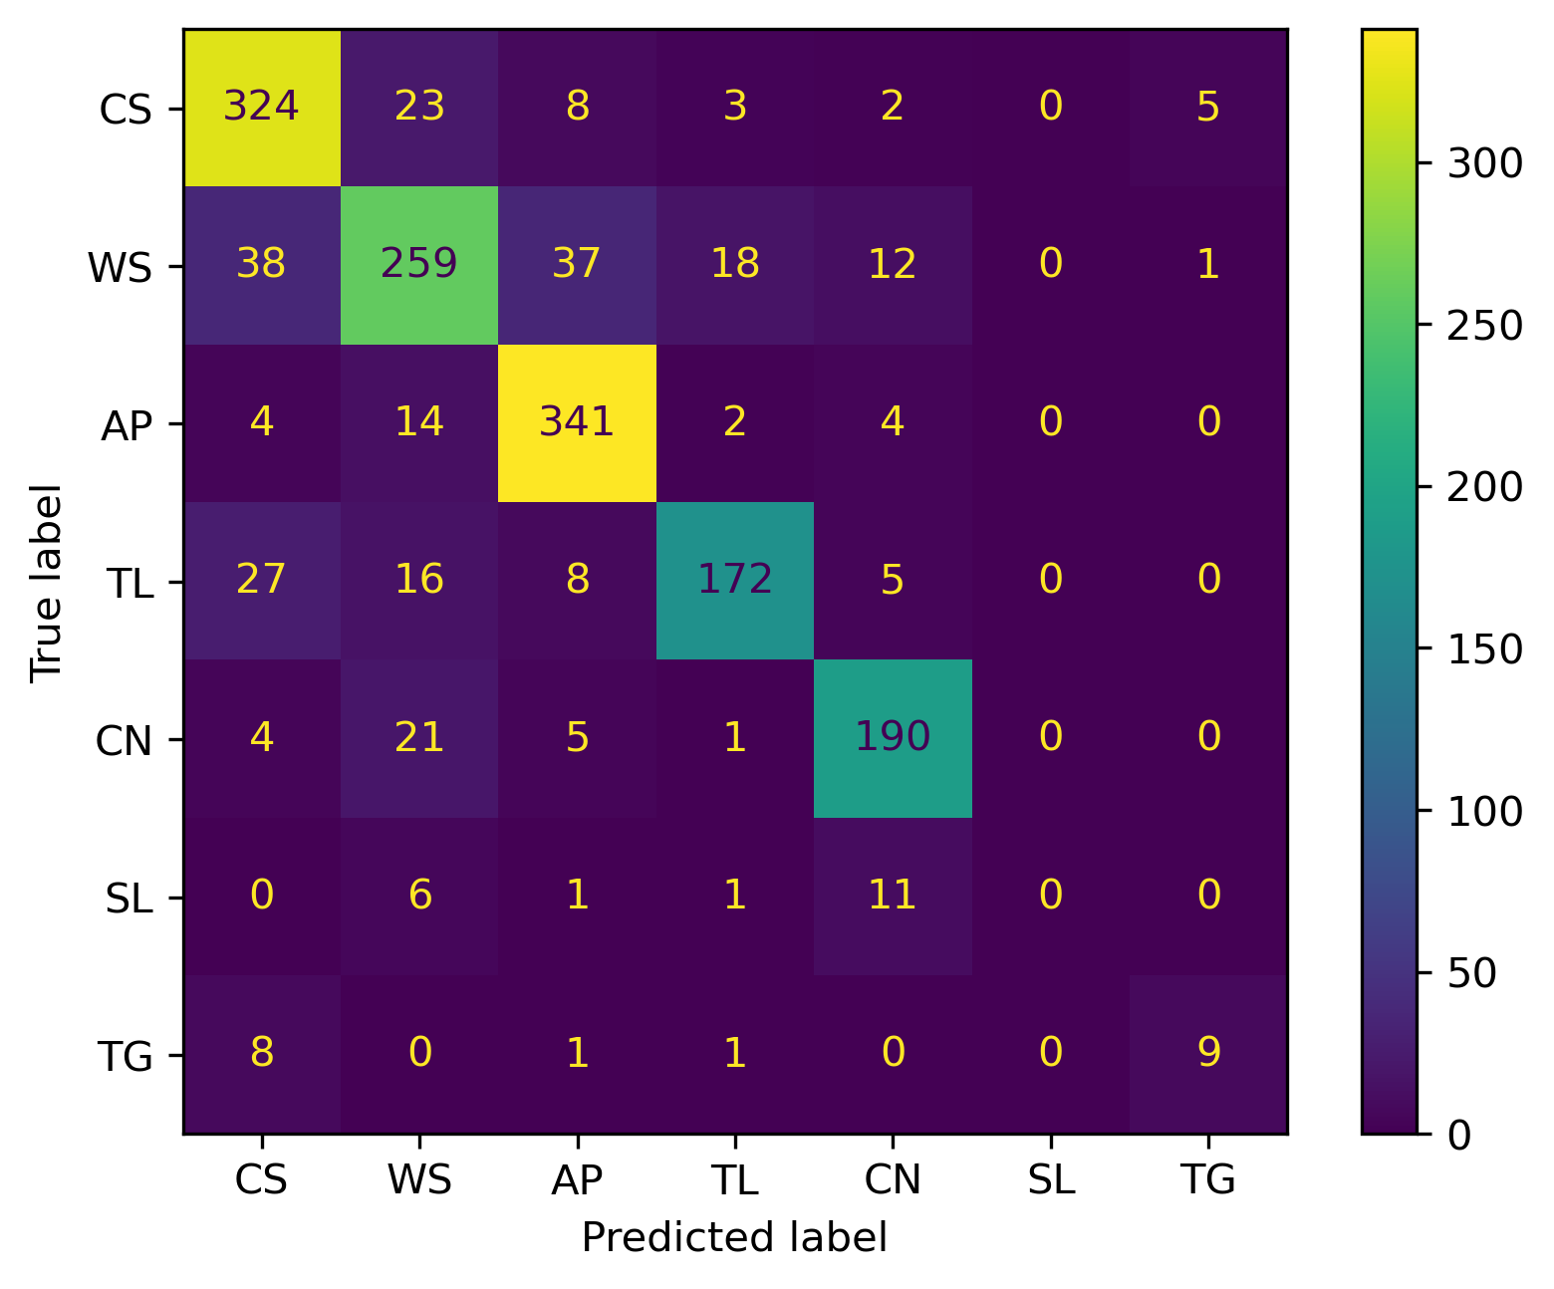
Figure SX
Resnet-18
XGBoost
Washington, D.C.
Denver, Colorado

Slide 9
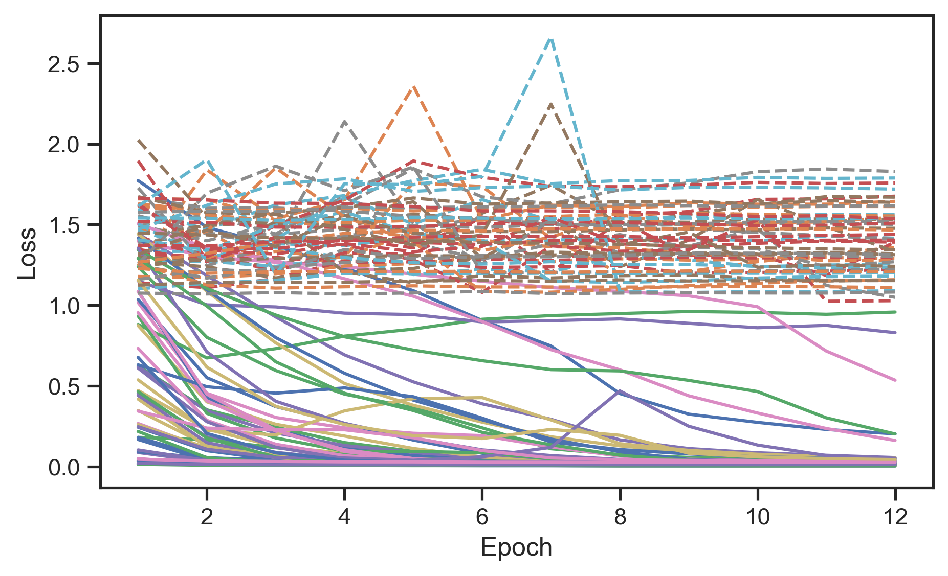
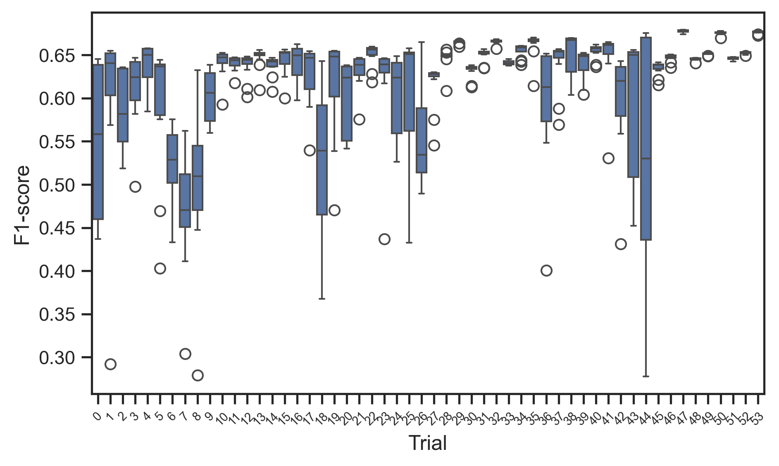
Figure SX
(a)
(b)

